Slide 1
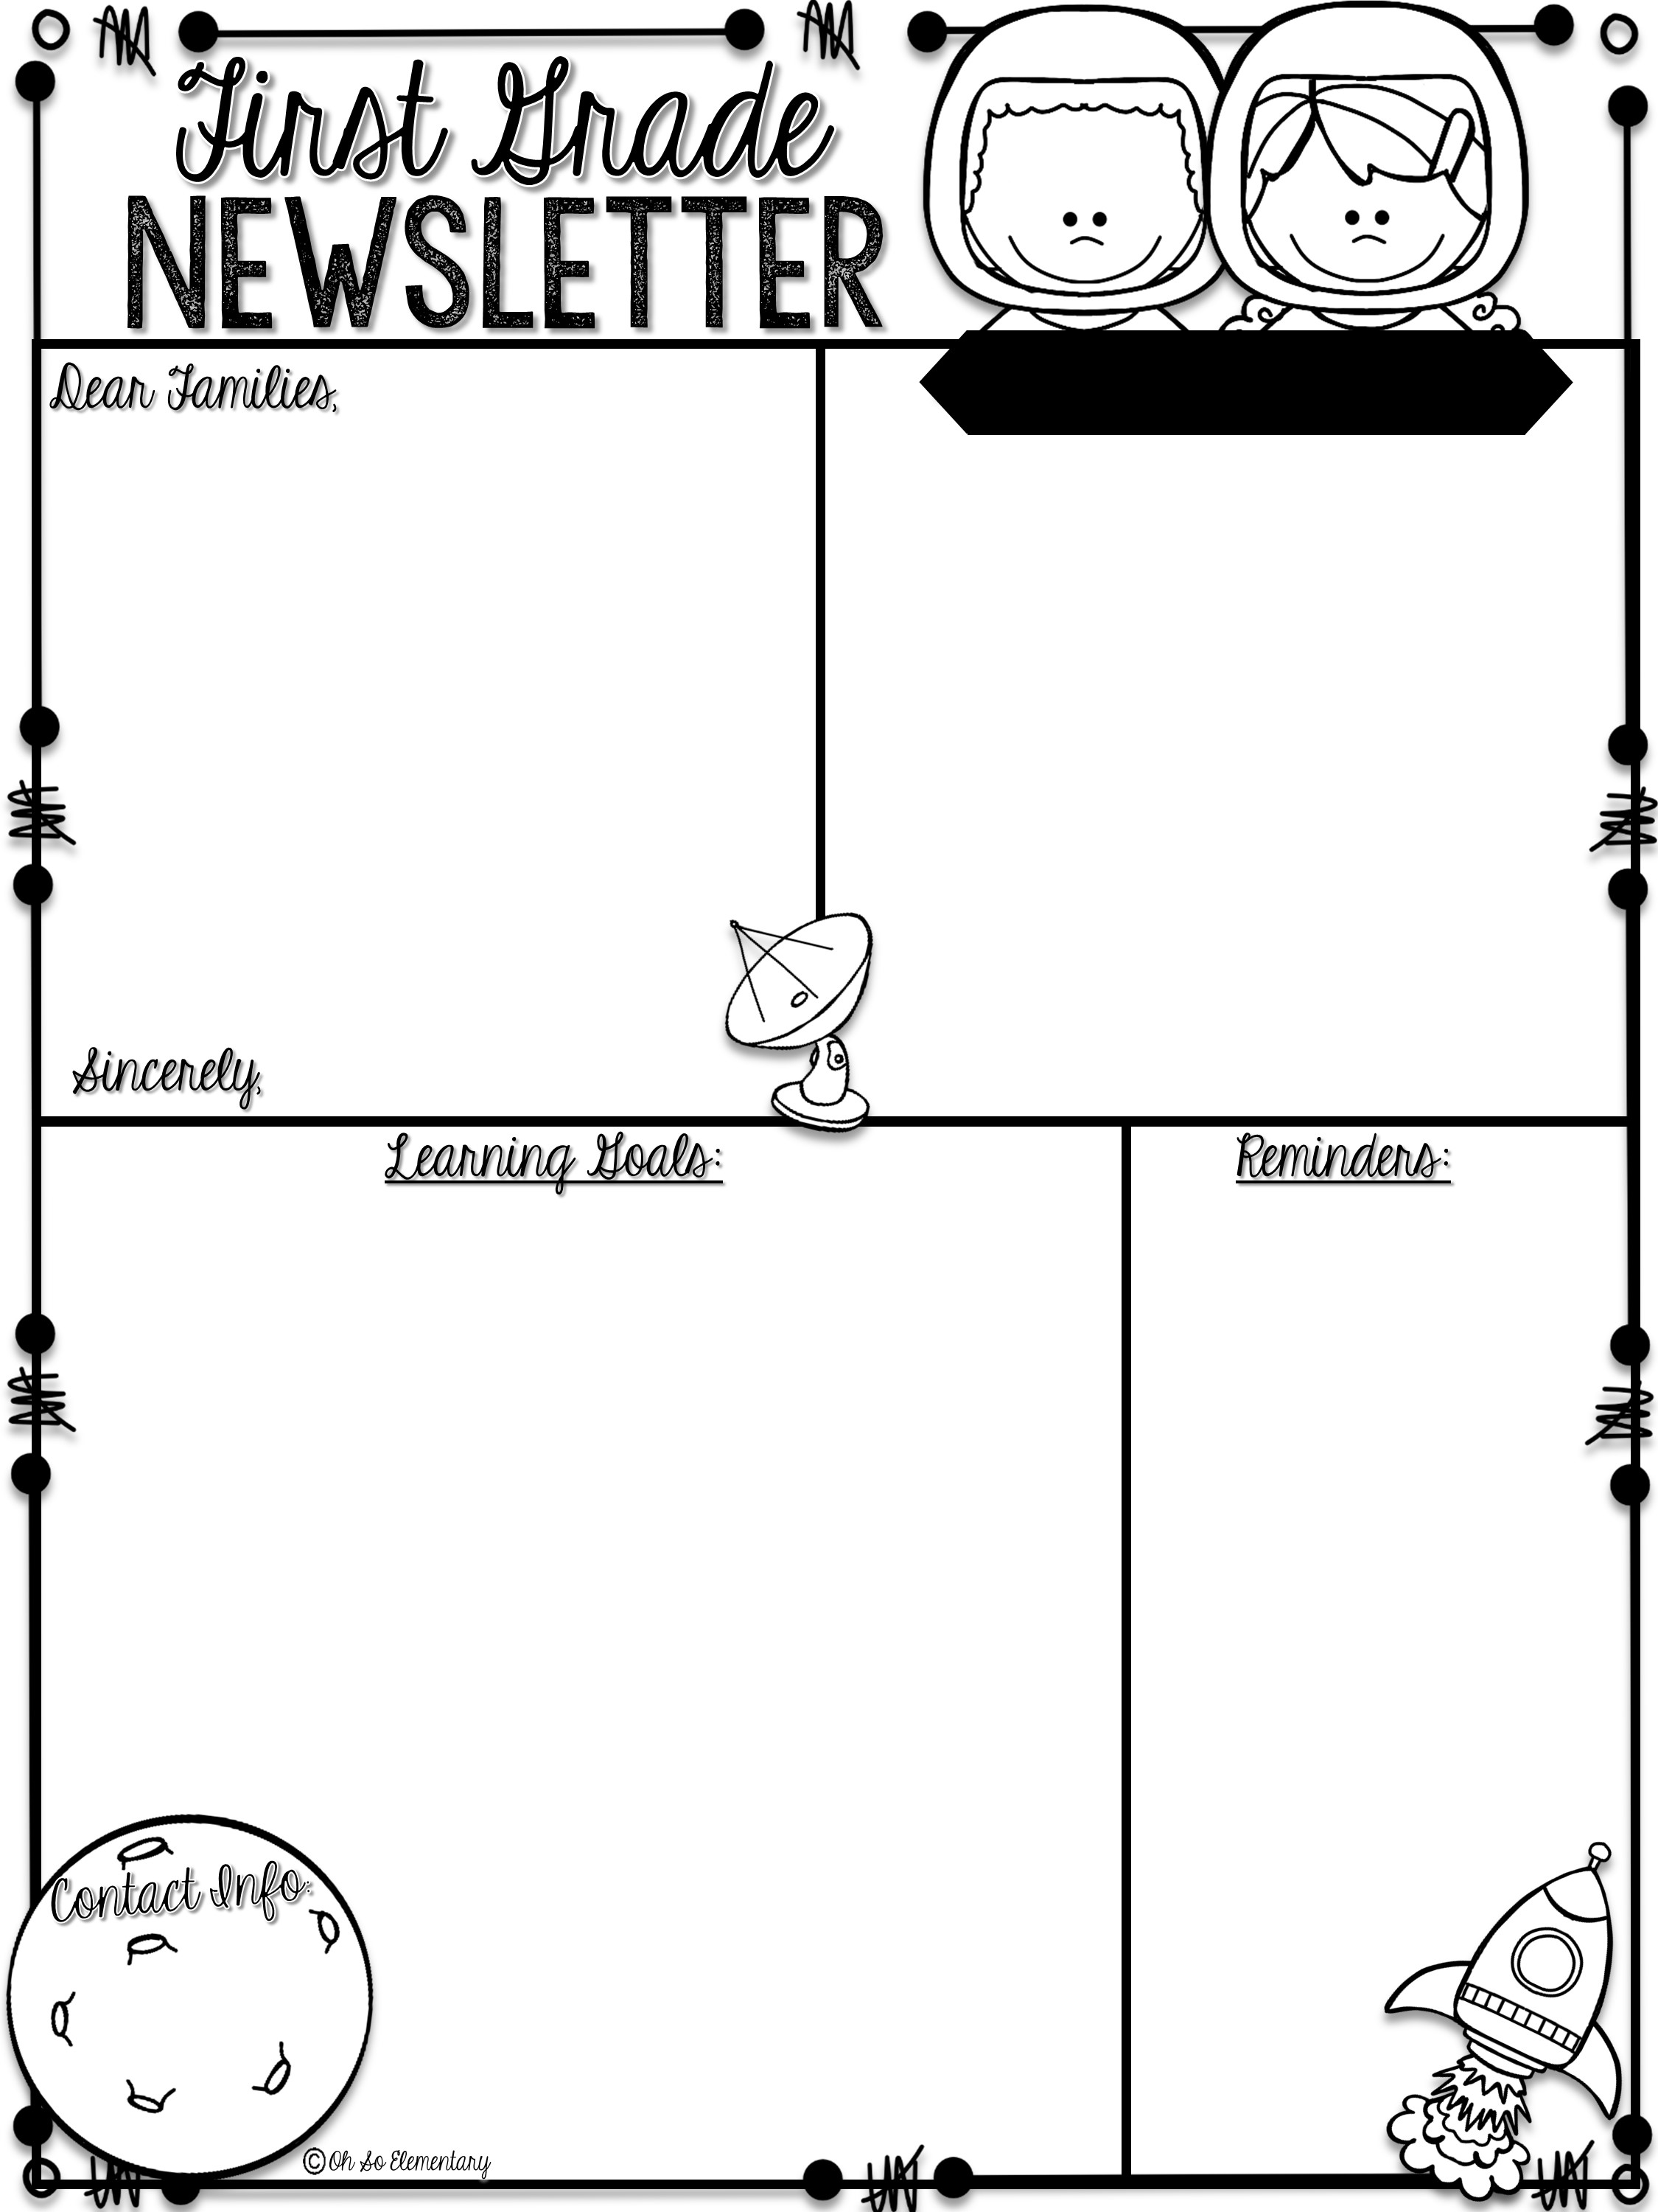
Week of August 28- September 1
Please remember to send a water bottle and snack daily.
Reading homework is on the back of this newsletter and math is in the folder/sleeve behind it.
Upcoming dates and events
Progress Reports- 9/7
School Pictures-9/7
Student of the Week
First Grade Teachers
Spelling
Theme: Teamwork | Phonics/Reading: Short o Review short i Language: Plural nouns s
Math: Add and subtract within 10 using counting strategies +3 Fact test | Writing: Answer questions about a story in complete sentences.
 | Homework: -Math workbook pages (Lesson 3) -Back of the newsletter
fox
fib
pod
hog
con
wig
Super Words
Review: and, see, the, to, but, her, not, of
New: do, that, they, was

Slide 2
ELA Homework Name_____________________
Mom
Mom has a tot. Her tot is Jon. Mom got Jon and sat him on her lap. Mom had a bib for Jon. Jon had ham and a fig. Jon ran to a cot. Jon ran to the pot. Mom said “Stop Jon! The pot is hot!” Jon ran to his pop and sat on his lap.
**Begin working with students on restating the question in answers. For example: The characters in the story are__________________.
Circle all the short o words with a blue crayon.
Circle the words that are nouns.
Who are the characters in the story? ______________________________
Where did Jon run first? ______________________________
Why did mom want Jon to stop?________________________________________________________

